Slide 1

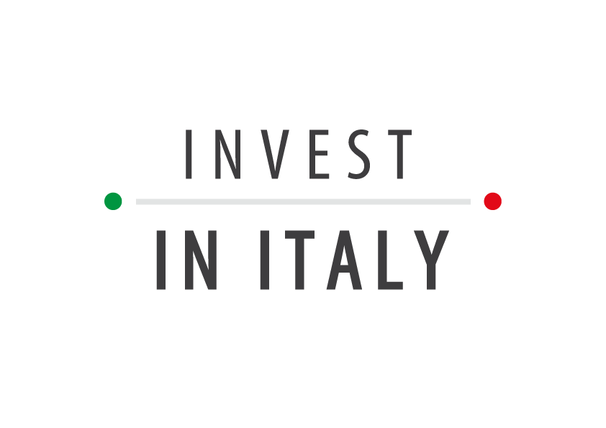

THE POWERPOINT PRESENTATION
ITALY
Vibrant ecosystem for
Life Sciences investments

Slide 2
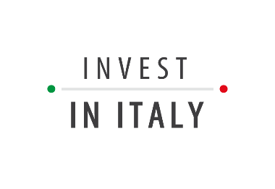
CONTENTS
Life sciences industry overview
Talent pool
R&D expertise
Innovation ecosystem
Incentives and fiscal benefits
FDI focus
2

Slide 3
LIFE SCIENCES IN ITALY: KEY FACTS
With a yearly production value of € 32 bln, the Italian pharma industry is leader in Europe
Largest pharma export growth in Europe: +117% from 2008 to 2018
(vs +58% Top EU Countries average)
In 2019, exports kept on growing by +29%
€ 1,7 bln pharma R&D investments: 35% growth rate over the last 5 years
1st in the EU for Life Sciences-related patent productivity
With € 1 bln yearly investments and 51 IRCSS (national hospitals dedicated to research), Italy is an ideal hub for Clinical Trials
3rd in Europe for no. of employees in pharma – about 65,000
Over 33K graduates per year in life sciences disciplines, 4K of which in biotech
Top destination for life sciences FDIs in Europe: 60% of pharma companies based in Italy are foreign-owned
Robust medical devices sector with about 4.000 companies and hosting the top global biomedical cluster ‘Mirandola district’
World-class R&D in a wide range of areas:
1st in the EU for citations in endocrinology, internal medicine, obstetrics and gynecology, and more
3

Slide 4
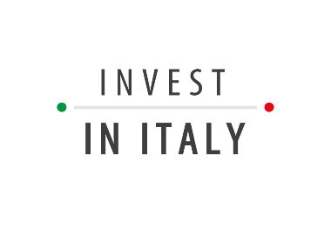


LS industry overview

Slide 5
Life Sciences in Italy
The Italian Life Sciences value chain accounts for 11% of GDP
PHARMA
With a pharma production value of € 32 bln in 2018, Italy with Germany has a role of leadership in Europe, also thanks to the quality of the supply and service chain – 2nd in the EU for pharma market size
BIOTECHNOLOGY
Therapeutic pipeline of 375 biotech projects, of which 73 in clinical development
MEDICAL DEVICES
Robust medical devices sector, accounting for about 4.000 companies and hosting the “Mirandola district”, one of the top biomedical clusters in the world
World-renowned National Healthcare System with universal coverage,
including a broad variety of excellent institutes as potential partners
5
Sources: Farmindustria; Assobiotec

Slide 6

Pharma industry
2017 Top EU countries for no. of pharma companies (NACE Code C 21)
Italy ranks 2nd in the EU for no. of companies involved in the manufacture of pharma products and preparations
Strong and historical presence of pharma with over 180 production sites
A balanced mix between Italian and foreign owned companies
Excellent pool of leading Italian pharma companies
Sources: Eurostat; Farmindustria
6
Notes:
Annual enterprise statistics for special aggregates of activities (NACE Rev. 2) - Eurostat
NACE Rev.2: Manufacture of pharmaceutical products and pharmaceutical preparations (C-21)
Indicator: number of enterprises
United Kingdom: 637
Germany: 521
Italy: 405
Spain: 353
France: 252
Netherlands: 206
Switzerland: 182
Sweden: 154
Belgium: 129
Denmark: 112
Austria: 89
Finland: 31

Slide 7
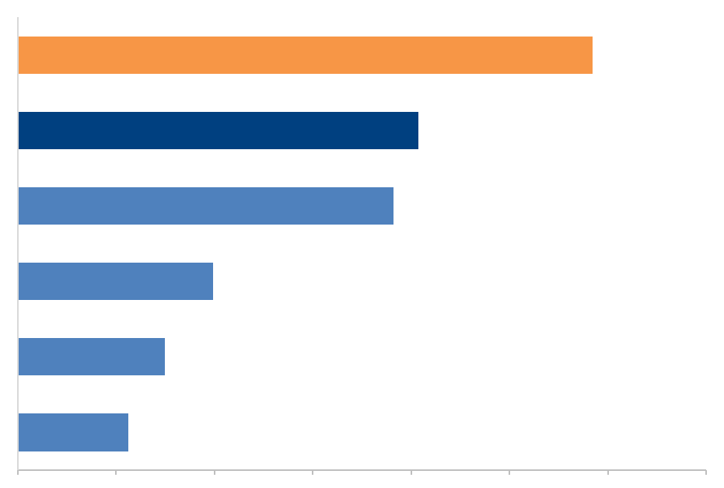
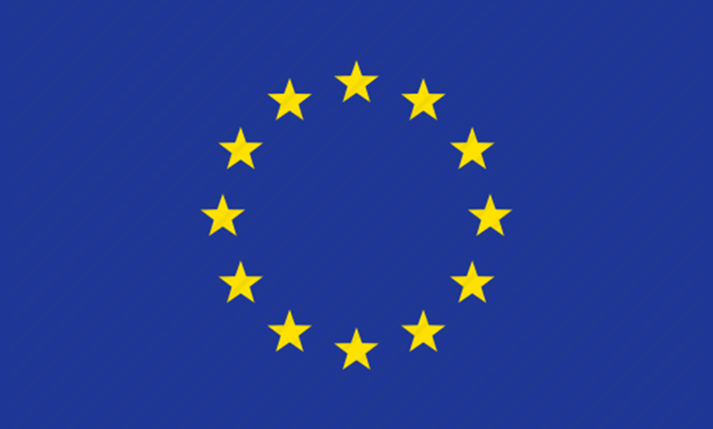




Pharma export
Pharma export: trend 2008-2018 for the big EU countries (% change)
+117%
Over the last 10 years pharma export in Italy has grown more than all big EU countries and more than big European countries’ average
Over the 80% of the huge manufacturing value
(€ 32 bn) is due to export (€ 25.9 bn)
The USA is the 3rd commercial partner of Italy, with a commercial interchange of over € 7.3 bn (14% of the total)
0%
20%
40%
60%
80%
100%
120%
140%
7
Source: Farmindustria, Assobiotec/Federchimica

Slide 8
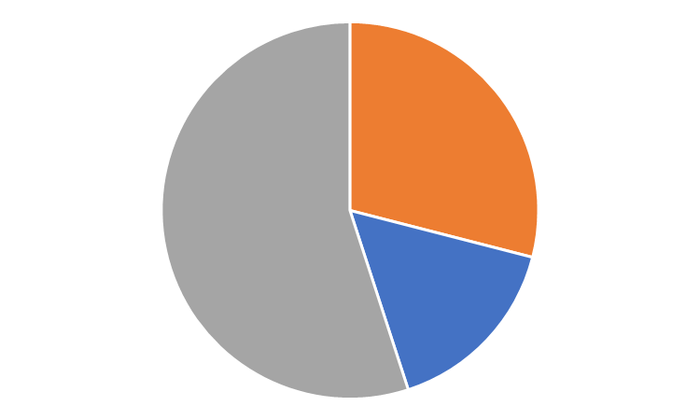
Pharma manufacturing expertise
Composition of pharmaceutical growth in the last 5 years
Pharma CDMO manufacturing value and employment in EU countries
New launches
Manufacturing
(euro mln)
1st for manufacturing value
Growing since 2010 in production (+41%, especially in innovative products) and export (+67%, especially towards advanced economies)
Constant investments on production lines and new technologies so as to endorse efficiency and products quality
29%
Growth of existing productions
EU total
7,900
55%
Italy
1,872
Attraction of productions once made abroad
16%
Germany
1,747
France
1,519
UK
784
Spain
496
1,483
Other EU countries (*)
The quality of Italy’s industrial pharma system has been a magnet for production activities previously carried out elsewhere in the world.
8
Source: Farmindustria, Assobiotec/Federchimica

Slide 9
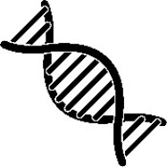
Biotech industry
TOT
COMPANIES
BIOTECH R&D COMPANIES...
...OF WHICH WITH ITALIAN CAPITAL
319
202
181
NO. OF COMPANIES
€ 8,6 bln
€ 3,2 bln
€ 648 mln
80% of Italian biotech industry is composed by SMEs which have boosted the growth of the entire sector
Between 2017 and 2019, over 50 new innovative startups operating in the biotech industry
BIOTECH TURNOVER
€ 1,7 bln
€ 409 mln
€ 342 mln
TOT R&D INVESTMENTS
€ 650 mln
€ 390 mln
€ 171 mln
TOT BIOTECH R&D INVESTMENTS
8.599
4.245
3.077
BIOTECH EMPLOYEES
3.158
2.359
1.401
BIOTECH R&D EMPLOYEES
9
Source: Assobiotec/Federchimica
Notes:
Numero imprese: 319 - 202 - 181
Fatturato biotech: 8.639.175.248 – 3.154.779.25 – 648.317.905
Investimenti R&S totali: 1.713.688.180 – 408.806.962 – 341.675.682
Investimenti R&S biotech totali: 650.056.128 – 389.922.165 – 171.006.510
Addetti biotech: 8.599 – 4.245 – 3.077
Addetti R&S biotech: 3.158 – 2.359 – 1.401

Slide 10
Medtech industry
The medical devices sector generates a market valued about € 16,5 bln in terms of export and internal market with about 4.000 companies employing 76.400 employees
66% of the market is directed to the National Healthcare System
1,5 mln of medical devices produced and distributed yearly
The sectorial companies are divided in 8 segments:
  Biomedical (44% of total) – orthopedic implants, patches, pacemakers, and more
  Biomedical equipment (18% of total) – equipment for surgery, monitoring, rehabilitation and support
  Substances-based (11% of total) – products with mechanical and not pharma action, e.g. eye drops
  Services and software (6% of total) – health tech maintenance services and health-Apps development
  In vitro diagnostics (6% of total) – laboratory analyses, molecular diagnostics, self-testing, and more
  Electro-medical (5% of total) – CAT, NMR, radiographs, ultrasound scanners, mammographs
10
Source: Confindustria Dispositivi Medici 2018
Notes:
CAT: Computed Axial Tomography → in italiano, TAC
NMR: Nuclear Magnetic Resonance → in italiano RMN

Slide 11
Talent Pool

Slide 12
Pharma employees in Europe
2017 Top European countries for no. of employees in pharma (NACE Code C 21)
Italy ranks 3rd in Europe for no. of employees involved in the manufacture of pharma products and preparations
+8,6% highly qualified employees over the last 5 years
90% with secondary school certification or university degree
Source: Eurostat
12
Notes:
Annual enterprise statistics for special aggregates of activities (NACE Rev. 2) – Eurostat
NACE Rev.2: Manufacture of pharmaceutical products and pharmaceutical preparations (C-21)
Indicator: number of employees
Time: 2017
Germany: 121.415
France: 96.992
Italy: 64.114
Switzerland: 46.568
United Kingdom: 43.739
Spain: 42.653
Belgium: 25.381
Austria: 14.888
Netherlands: 12.947
Sweden: 12.902
Finland: 4.615

Slide 13
Academic human capital
Students and graduates in Life sciences-related disciplines per year
UNIVERSITY COURSES
GRADUATES
STUDENTS
PHARMACY AND INDUSTRIAL PHARMACY
5.073
40.767
Italian university system boasts a large number of students and graduates in disciplines related to life sciences, thus generating a cutting-edge talent pool of human resources available for innovative companies
PHARMA SCIENCES AND TECHNOLOGIES
869
7.266
BIOTECH AND BIOTECH TRADES
4.205
23.649
BIOMEDICAL ENGINEERING
1.182
4.512
MEDICINE AND VETERINARY MEDICINE
11.050
87.348
BIOLOGY
7.345
38.152
CHEMISTRY AND CHEMISTRY TRADES
3.933
19.727
TOTAL
33.657
163.542
Source: MIUR (Ministry of Education University and Research)
13
Notes:
STUDENTS: Iscritti AnnoAA 2018/2019
GRADUATES: Laureati 2015-2018
Pharmacy and industrial pharmacy - Farmacia e farmacia industriale (classe nome):
Chimica e Tecnologia Farmaceutica
Farmacia
Pharma sciences and technologies – Scienze e tecnologie farmaceutiche (classe nome):
Controllo qualità e affini
Scienze e tecnologie cosmetiche e affini
Scienze e tecnologie erboristiche e affini
Tossicologia e affini
Scienza della nutrizione
Biotech and biotech trades –
Biotecnologie (classe nome)
Biotecnologie mediche, veterinarie e farmaceutiche (classe nome)
Biotecnologie agrarie (classe nome)
Biotecnologie industriali (classe nome)
Medicine and veterinary medicine –
Medicina e chirurgia (classe nome)
Medicina veterinaria (classe nome)
Biology –
Biologia (classe nome)
Scienze biologiche (classe nome)
Chemistry and chemistry trades –
Ingegneria chimica (classe nome)
Scienze chimiche (classe nome)
Scienze e tecnologie chimiche (classe nome)
Scienze e technologie della chimica industrial (classe nome)

Slide 14
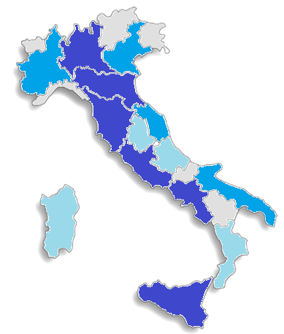
Over 20.000
Life Sciences Human Resources in Italy
Regional distribution of graduates and students per year
The top 3 regions for combined number of students and graduates are Lombardy (35.226), Campania (31.299), and Lazio (27.692)
From 10.000 to 20.000
From 5.000 to 10.000
Up to 5.000
Source: MIUR (Ministry of Education University and Research)
14
Notes:
GRADUATES: 2018
Tutte le facoltà di cui nella slide precedente:
Puglia (Bari, Foggia, Salento): 1.377
Basilicata (Basilicata): 112
Emilia-Romagna (Bologna, Ferrara, Modena e Reggio Emilia, Parma): 3.883
Lombardia (Brescia, Insubria, Milano, Milano Politecnico, Milano S. Raffaele, Milano Bicocca, Rozzano (MI) Humanitas, Pavia): 5.351
Sardegna (Cagliari, Sassari): 822
Calabria (Calabria, Catanzaro): 793
Marche (Camerino, Marche, Urbino): 1.312
Sicilia (Catania, Messina, Palermo): 2.440
Abruzzo (Chieti e Pescara, L’Aquila, Teramo): 1.094
Toscana (Firenze, Pisa, Siena): 2.579
Liguria (Genova): 657
Molise (Molise): 108
Campania (Napoli Fed. II, Napoli Parthenope, Napoli Vanvitelli, Salerno, Sannio): 3.786
Veneto (Padova, Venezia Cà Foscari, Verona): 1.750
Umbria (Perugia): 774
Piemonte (Piemonte Orientale, Torino, Torino Politecnino): 2.380
Lazio (Roma La Sapienza, Roma Tor Vergata, Roma Tre, Tuscia): 3.324
Provincia di Trento (Trento): 132
Friuli Venezia Giulia (Trieste, Udine): 728
STUDENTS: 2018/2019
Puglia (Bari, Foggia, Salento): 9.815
Basilicata (Basilicata): 980
Emilia-Romagna (Bologna, Ferrara, Modena e Reggio Emilia, Parma): 23.449
Lombardia (Brescia, Insubria, Milano, Milano Cattolica, Milano Politecnico, Milano S. Raffaele, Milano Bicocca, Novedrate e-campus, Rozzano (MI) Humanitas, Pavia): 29.875
Sardegna (Cagliari, Sassari): 6.754
Calabria (Calabria, Catanzaro): 6.966
Marche (Camerino, Marche, Urbino): 9.232
Sicilia (Catania, Messina, Palermo): 17.804
Abruzzo (Chieti e Pescara, L’Aquila, Teramo): 7.202
Toscana (Firenze, Pisa, Siena): 17.712
Liguria (Genova): 3.784
Molise (Molise): 1.068
Campania (Napoli Fed. II, Napoli Parthenope, Napoli Vanvitelli, Salerno, Sannio): 27.513
Veneto (Padova, Venezia Cà Foscari, Verona): 9.776
Umbria (Perugia): 4.995
Piemonte (Piemonte Orientale, Torino, Torino Politecnino): 15.805
Lazio (Roma Biomedico, Roma La Sapienza, Roma Saint Camillus, Roma Tor Vergata, Roma Tre, Tuscia): 24.368
Provincia di Trento (Trento): 483
Friuli Venezia Giulia (Trieste, Udine): 3.480
TOTALI:
Puglia (Bari, Foggia, Salento): 11.192
Basilicata (Basilicata): 1.092
Emilia-Romagna (Bologna, Ferrara, Modena e Reggio Emilia, Parma): 27.332
Lombardia (Brescia, Insubria, Milano, Milano Politecnico, Milano S. Raffaele, Milano Bicocca, Rozzano (MI) Humanitas, Pavia): 35.226
Sardegna (Cagliari, Sassari): 7.576
Calabria (Calabria, Catanzaro): 7.759
Marche (Camerino, Marche, Urbino): 10.544
Sicilia (Catania, Messina, Palermo): 20.244
Abruzzo (Chieti e Pescara, L’Aquila, Teramo): 8.296
Toscana (Firenze, Pisa, Siena): 20.291
Liguria (Genova): 4.441
Molise (Molise): 1.176
Campania (Napoli Fed. II, Napoli Parthenope, Napoli Vanvitelli, Salerno, Sannio): 31.299
Veneto (Padova, Venezia Cà Foscari, Verona): 11.526
Umbria (Perugia): 5.769
Piemonte (Piemonte Orientale, Torino, Torino Politecnino): 18.185
Lazio (Roma La Sapienza, Roma Tor Vergata, Roma Tre, Tuscia): 27.692
Provincia di Trento (Trento): 615
Friuli Venezia Giulia (Trieste, Udine): 4.208

Slide 15
Labour cost competitiveness
2019 Labour cost per hour of employees in manufacturing in the EU (NACE Code C)
Italy is extremely competitive in terms of hourly labour cost
Source: Eurostat.
15
Notes:
Labour cost levels by NACE Rev. 2 activity
NACE Rev. 2: C - Manufacturing
Labour cost structure: wages and salaries (total) + labour costs other than wages and salaries
Unit of measure: Euro
Denmark: 40,8+ 6 → 46.8
Belgium: 32 + 11,6 → 43.5
Germany: 32,2 + 8,7 → 40.9
Sweden: 27 + 13,2 → 40.2
France: 26,2 + 12,4 → 38.6
Austria: 28,4 + 10,0 → 38.5
Finland: 29,7 + 7,3 → 37
Ireland: 27,3 + 6 → 33.3
Italy: 20,1 + 8,2 → 28.3
Spain: 17,2 + 6,2 → 23.4

Slide 16
Hard working attitude
2018 Average annual hours actually worked (hours per worker)
Italy ensures a high level of commitment in terms of hours worked and energy from its workers
Source: OECD database.
16
Notes:
The concept used is the total number of hours worked over the year divided by the average number of people in employment. Part-time workers are covered as well as full-time workers.

Slide 17
R&D expertise

Slide 18
R&D Investments
€ 1,7 bln pharma R&D investments
  +35% for R&D in the last 5 years (more than the EU, +20%)
Worldwide excellence for biotech, vaccines, blood derivatives, orphan drugs, advanced therapies
  375 biotech medicines in development
Commitment and investment in the area of infectious diseases are confirmed in the first quarter of 2020. The contribution of biotechnology in the collective mobilization phase to fight the SARSCoV-2 coronavirus is crucial.
Innovation is the result of the network between companies and public-private partnership, non-profit, universities, biotech SMEs, start-up and no-profit companies
18
Source: Farmindustria, Assobiotec/Federchimica

Slide 19
R&D Productivity
2018 Top 5 European Countries for patent productivity in the field of Life sciences (granted applications / filed applications)
This data represents the high quality of the Italian filed patents since most of them are granted
19
Source: ‘Il ruolo dell’ecosistema dell’innovazione nelle Scienze della Vita per la crescita e la competitività dell’Italia’, Technology Forum Life Sciences 2019, The European House Ambrosetti

Slide 20

Top research in medicine in 1996-2018
₇th
in the world for citations in medicine
₃rd
₁st
₄th
₅th
in the world and first in the EU for citations in:
Biochemistry (medical)
Endocrinology
Hepatology
Internal medicine
Obstetrics and gynecology
in the world for citations in:
Cardiology and Cardiovascular medicine
Geriatrics and gerontology
Hematology
Reproductive medicine
Urology
in the world for citations in:
Oncology
Gastroenterology
Nephrology
Neurology
Otorhinolaryngology
Respiratory medicine
Transplantation
Source: SCImago, (n.d.). SJR — SCImago Journal & Country Rank [Portal]. Retrieved Date you Retrieve, from http://www.scimagojr.com
20
Notes:
The macro area ‘Medicine’ includes:
Anatomy (6th in the world)
Anesthesiology and Pain Medicine (7th in the world)
Biochemistry (medical) (3th in the world; 2nd in Europe; 1st in the EU)
Cardiology and Cardiovascular Medicine (4th in the world; 3rd in Europe; 2nd in the EU)
Complementary and Alternative Medicine (10th in the world)
Critical Care and Intensive Care medicine (6th in the world)
Dermatology (6th in the world; 4th in Europe; 3rd in the EU)
Drug guides (17th in the world)
Embryology (8th in the world)
Emergency Medicine (6th in the world)
Endocrinology, diabetes and metabolism (3th in the world; 2nd in Europe; 1st in the EU)
Epidemiology (8th in the world)
Family practice (18th in the world)
Gastroenterology (5th in the world)
Genetics (clinical) (7th in the world)
Geriatrics and gerontology (4th in the world)
Health informatics (9th in the world)
Health policy (10th in the world)
Hematology (4th in the world; 3rd in Europe; 2nd in the EU)
Hepatology (3th in the world; 1st in Europe; 1st in the EU)
Histology (6th in the world)
Immunology and allergy (6th in the world)
Infectious diseases (11th in the world)
Internal medicine (3th in the world; 2nd in Europe; 1st in the EU)
Medicine (miscellaneous) (8th in the world)
Microbiology (medical) (8th in the world)
Nephrology (5th in the world)
Neurology (clinical) (5th in the world)
Obstetrics and gynecology (3th in the world; 2nd in Europe; 1st in the EU)
Oncology (5th in the world; 3rd in Europe; 2nd in the EU)
Ophthalmology (7th in the world; 3rd in Europe; 2nd in the EU)
Orthopedics and Sports medicine (11th in the world)
Otorhinolaryngology (5th in the world)
Pathology and forensic medicine (6th in the world)
Pediatrics, perinatology and child health (6th in the world)
Pharmacology (medical) (6th in the world; 4th in Europe; 3rd in the EU)
Physiology (medical) (6th in the world)
Psychiatry and mental health (7th in the world)
Public health, environmental and occupational health (10th in the world)
Pulmonary and respiratory medicine (5th in the world)
Radiology, nuclear medicine and imaging (8th in the world)
Rehabilitation (6th in the world)
Reproductive medicine (4th in the world)
Reviews and references (medical) (5th in the world)
Rheumatology (7th in the world)
Surgery (5th in the world)
Transplantation (5th in the world)
Urology (4th in the world; 3rd in Europe; 2nd in the EU)

Slide 21
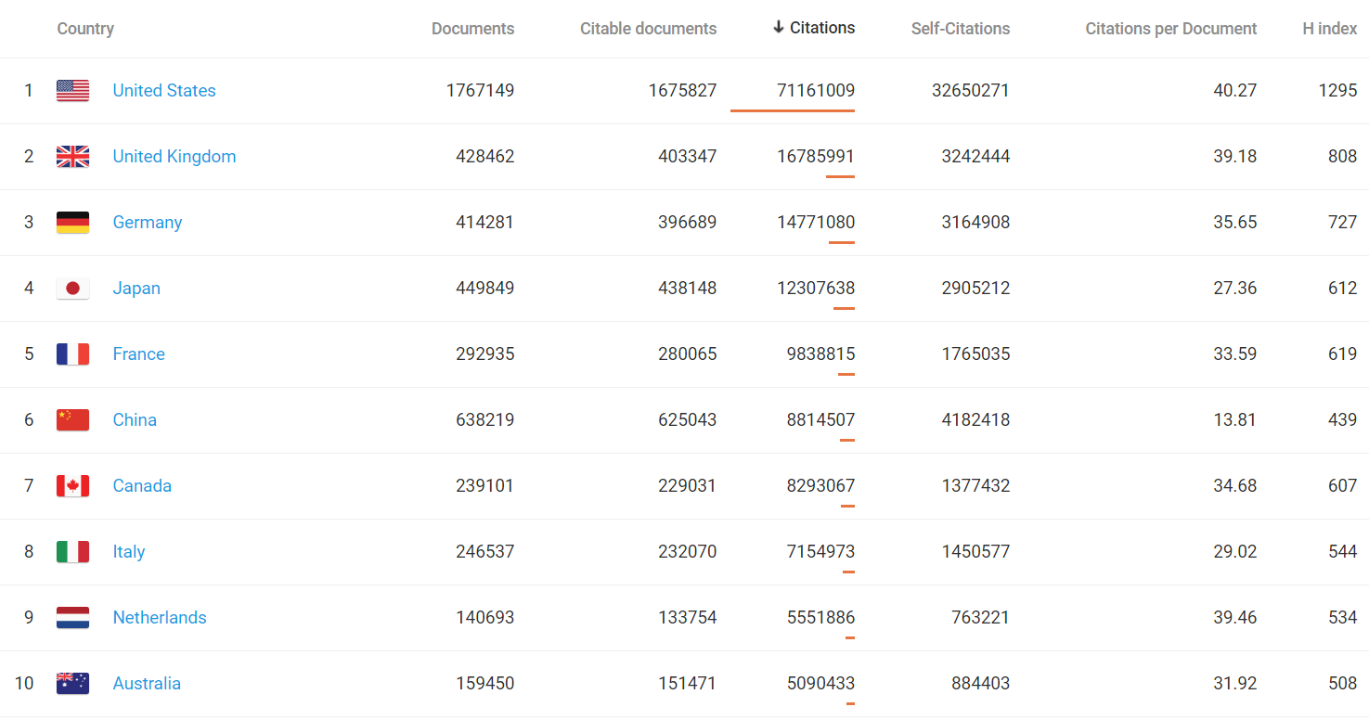
Citations in biochemistry and genetics
Italy ranks 8th in the world for citations in biochemistry, genetics, and molecular biology in 1996-2018
(11th in the world for citations in the sole biotechnology)
Source: SCImago, (n.d.). SJR — SCImago Journal & Country Rank [Portal]. Retrieved Date you Retrieve, from http://www.scimagojr.com
21
Notes:
The macro area of ‘biochemistry, genetics, and molecular biology’ includes:
Aging (3th in the world; 2nd in Europe; 1st in the EU)
Biochemistry (8th in the world)
Biochemistry, genetics and molecular biology (miscellaneous) (8th in the world)
Biophysics (8th in the world)
Biotechnology (11th in the world; 6th in Europe; 5th in the EU)
Cancer research (5th in the world; 3rd in Europe; 2nd in the EU)
Cell biology (7th in the world)
Clinical biochemistry (4th in the world; 3rd in Europe; 2nd in the EU)
Development biology (7th in the world)
Endocrinology (4th in the world; 3rd in Europe; 2nd in the EU)
Genetics (8th in the world)
Molecular biology (8th in the world)
Molecular medicine (6th in the world)
Physiology (8th in the world)
Structural biology (9th in the world)

Slide 22
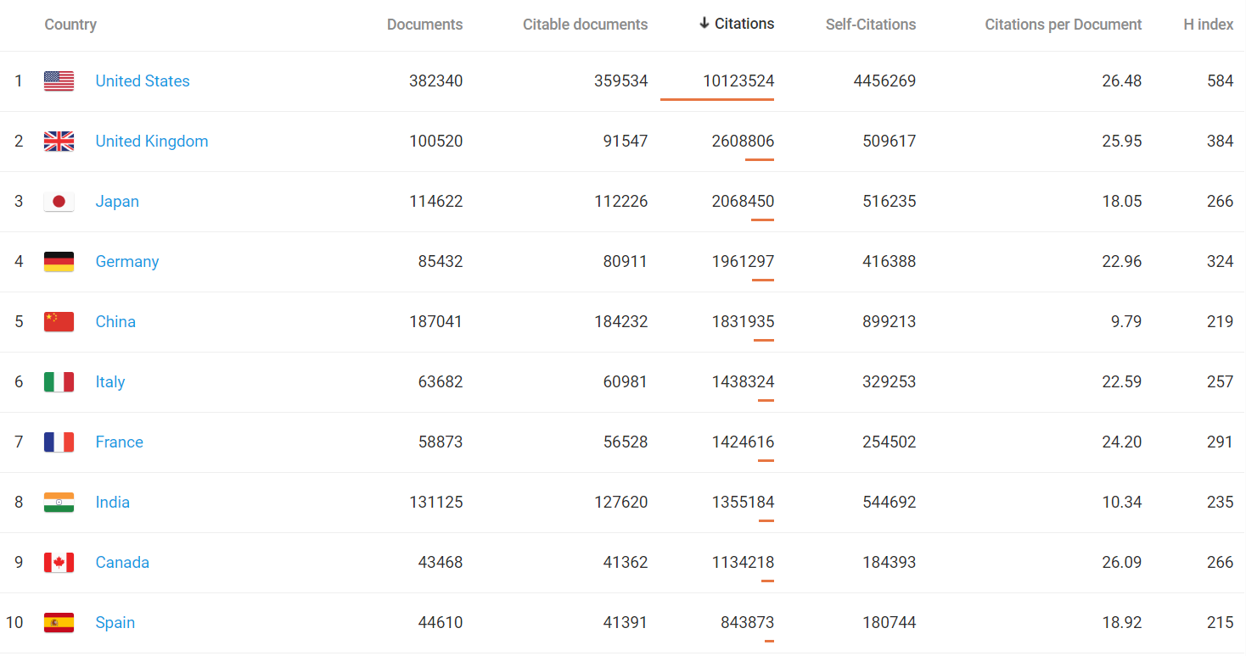
Citations in pharma
Italy ranks 6th in the world for citations in pharmacology, toxicology, and pharmaceutics in 1996-2018
(5th in the world for citations in the area of pharmacology AND
7th in the world in the area of pharmaceutical science)
Source: SCImago, (n.d.). SJR — SCImago Journal & Country Rank [Portal]. Retrieved Date you Retrieve, from http://www.scimagojr.com
22
Notes:
The macro area of ‘pharmacology, toxicology, and pharmaceutics’ includes:
Drug discovery (7th in the world)
Pharmaceutical science (7th in the world; 3rd in Europe; 2nd in the EU)
Pharmacology (5th in the world; 3rd in Europe; 2nd in the EU)
Pharmacology, toxicology and pharmaceutics (miscellaneous) (9th in the world)
Toxicology (8th in world)

Slide 23
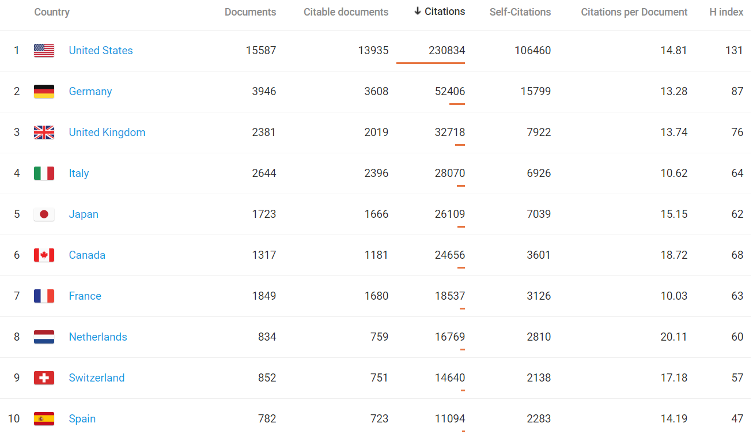
Citations in medical laboratory tech
Italy ranks 4th in the world for citations in Medical Laboratory Technology in 1996-2018
(9th in the world for citations in the macro area of health professions)
Source: SCImago, (n.d.). SJR — SCImago Journal & Country Rank [Portal]. Retrieved Date you Retrieve, from http://www.scimagojr.com
23
Notes:
The macro area ‘Health professions’ includes:
Chiropratics (16th in the world)
Complementary and manual therapy (8th in the world)
Emergency medical services (49th in the world)
Health information management (6th in the world)
Health professions (miscellaneous) (11th in the world)
Medical assisting and transcription (19th in the world)
Medical laboratory technology (4th in the world; 3rd in Europe; 2nd in the EU)
Medical terminology (18th in the world)
Occupational therapy (30th in the world)
Optometry (16th in the world)
Pharmacy (29th in the world)
Physical therapy, sports therapy and rehabilitation (9th in the world)
Podiatry (10th in the world)
Radiology and ultrasound technology (7th in the world)
Respiratory care (3th in the world; 2nd in Europe; 1st in the EU)
Speech and hearing (10th in the world)
Sports science (11th in the world)

Slide 24

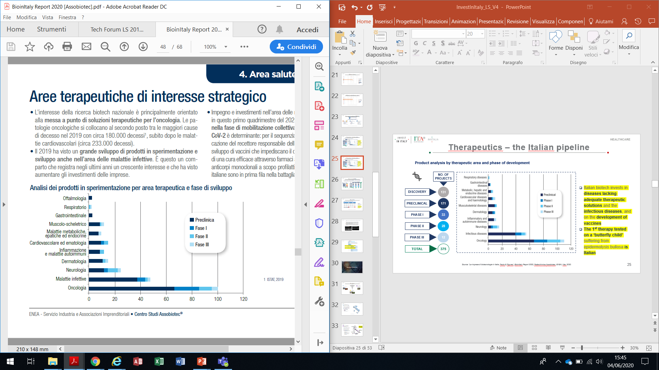
Therapeutics – the Italian pipeline
Product analysis by therapeutic area and phase of development
NO. OF PROJECTS
Ophtalmology
Respiratory diseases
The interest of national biotech research is mainly oriented towards the development of therapeutic solutions for oncology
2019 saw a great development of products in testing and development also in the area of infectious diseases
DISCOVERY
131
Gastrointestinal diseases
Musculoskeletal diseases
Preclinical
171
Metabolic, hepatic and endocrine diseases
Phase I
PRECLINICAL
Phase II
Cardiovascular diseases and haemotology
Phase III
PHASE I
33
Inflammatory and autoimmune diseases
PHASE II
28
Dermatology
Neurology
PHASE III
12
Infectious diseases
Oncology
TOTAL
375
0
20
40
60
80
100
120
24
Source: ‘Le imprese di biotecnologie in Italia. Facts & Figures’, BioInItaly Report 2020, Federchimica Assobiotec, ENEA, May 2020.

Slide 25
Orphan drugs & ATMPs
The rare disease and Advanced Therapy Medicinal Products (ATMPs) represent areas of excellence of Italian research
Italy ranks 1st for no. of scientific publications on rare diseases
12 biotech companies have obtained at least 1 orphan drug designation while 4 products received the double designation by both the European Medicines Agency (EMA) and the US Food and Drug Administration (FDA)
CELL
THERAPY
GENE THERAPY
REGENERATIVE THERAPY
TOTAL
ORPHAN DRUG DESIGNATION
NO. OF PROJECTS
DISCOVERY
3
5
0
8
EMA
8
PRECLINICAL
6
9
12
27
FDA
2
PHASE I
0
5
0
5
EMA + FDA
4
PHASE II
4
1
0
5
TOTAL
14
TOTAL
13
20
12
45
25
Source: ‘Le imprese di biotecnologie in Italia. Facts & Figures’, BioInItaly Report 2020, Federchimica Assobiotec, ENEA, May 2020.
Notes:
FDA: US Food and Drug Administration

Slide 26
Clinical Trials
2014-2018 Clinical Trials (CT) per year: EU – Italy comparison
Year | CT in the EU* | CT presented in Italy | % Italy / EU | CT authorized in Italy | % Italy / EU
2014 | 3.249 | 723 | 22,3 | 592 | 18,2
2015 | 3.918 | 744 | 19,0 | 672 | 17,2
2016 | 3.255 | 767 | 23,6 | 660 | 20,3
2017 | 3.125 | 669 | 21,4 | 564 | 18,0
2018 | 3.256 | 716 | 22,0 | 666 | 20,5
In 2018, the tot no. of presented and authorized Clinical Trials in Italy increased – vs the consistent European CT
About half of CTs are in the fields of oncology and emato-oncology
Most growing CTs’ fields are: rare diseases (31,5% of total) and pediatric (11,4% of total)
* no. of studies uploaded in the European system
26
Source: «La Sperimentazione Clinica dei Medicinali in Italia - 18° Rapporto Nazionale, Anno 2019», AIFA
Notes:
SPIEGAZIONE TABELLA: Nella Tabella 3 è riportato il numero delle sperimentazioni cliniche caricate nel database europeo EudraCT e il numero delle sperimentazioni presentate e autorizzate in Italia nel quinquennio 2014-2018. Dal confronto emerge che il numero totale delle sperimentazioni presentate (e autorizzate) in Italia nel 2018 è aumentato, a fronte di un numero totale di sperimentazioni in Europa rimasto costante; di conseguenza, la percentuale delle sperimentazioni condotte in Italia rispetto al resto d’Europa è tornata a livelli paragonabili a quelli del 2016 (oltre il 20%). Il numero di sperimentazioni cliniche nell’Unione Europea è stato ricavato dalle statistiche pubblicate sul sito EudraCT (“EudraCT supporting documentation” – “EudraCT statistics”, https://eudract.ema.europa.eu/statistics.html). Questo numero potrebbe non corrispondere esattamente a quello delle sperimentazioni avviate nel 2018 in considerazione delle tempistiche di approvazione non ricavabili nei vari Stati membri.
CONTESTO:
Dopo il calo del 2017, il numero totale delle sperimentazioni presentate in Italia nel 2018 è tornato ai livelli degli anni precedenti, pur in un contesto di costante contrazione delle sperimentazioni globali europee, che ha portato a un incremento della percentuale di sperimentazioni condotte in Italia rispetto al resto d’Europa (oltre il 20%). Probabilmente il dato potrebbe riflettere una prima ricaduta dell’avvicinarsi della Brexit, con lo spostamento degli Sponsor verso altri Stati membri, ma potrebbe anche significare un aumento di fiducia nel sistema italiano delle sperimentazioni cliniche in seguito alla pubblicazione della Legge n. 3/2018 e conseguenti aspettative su una progressiva riorganizzazione e semplificazione a livello nazionale in previsione dell’applicazione futura del Regolamento (UE) 536/2014, che nel 2018 ha visto come primo passo l’istituzione del Centro di Coordinamento nazionale dei Comitati etici territoriali. L’aumento è presente come numero assoluto in tutte le tipologie di sperimentazioni, pur mostrando un andamento diversificato. L’unico dato in controtendenza è la diminuzione percentuale delle sperimentazioni internazionali rispetto a quelle puramente nazionali, che hanno un incremento anche in numero assoluto più significativo.
Anche nel 2018 la distribuzione delle sperimentazioni per area terapeutica conferma il dato degli anni precedenti, con circa la metà delle sperimentazioni in ambito oncologico ed emato-oncologico. Continua in maniera significativa il trend in rialzo dei trial in malattie rare, che rappresentano il 31,5% del totale (25,5% nel 2017), di cui quasi l’80% sperimentazioni profit, con una distribuzione equilibrata fra le varie fasi di sperimentazione; aumentano ancora le sperimentazioni di fase I su malattie rare (33,7%) e significativa è soprattutto la percentuale di sperimentazioni con prodotti di terapia avanzata in malattie rare (11%, a fronte di un incremento globale delle sperimentazioni con prodotti di terapia avanzata pari al 4,7%).
Continua il trend in aumento delle sperimentazioni no profit rispetto al totale delle sperimentazioni condotte in Italia, arrivando nel 2018 a quota 27,3%; rispetto al 2017, è significativo anche l’aumento del numero assoluto di sperimentazioni no profit.
Un dato che mostra per la prima volta una inversione di tendenza è quello relativo alle sperimentazioni pediatriche, che salgono all’11,4% del totale rispetto al 9% dello scorso anno e degli anni immediatamente precedenti.
Sono state inserite nel Rapporto le tabelle relative alla distribuzione delle sperimentazioni per Sponsor profit e no profit e alla distribuzione dei pareri unici su base regionale e per singolo Comitato etico coordinatore.
Anche in questa edizione del Rapporto sono presentati i dati relativi alla partecipazione dell’Italia al progetto Voluntary Harmonization Procedure (VHP) per la valutazione congiunta dei protocolli clinici che si svolgono in più Stati dell’Unione Europea. Nel 2018 si è osservato un lievissimo incremento del numero totale condotto in Europa, mentre il numero delle richieste di partecipazioni dell’Italia alle VHP è rimasto identico rispetto al 2017 (117). Anche nel 2018 l’Italia è stato uno dei principali Stati membri a gestire le VHP quale Reference Member State: il dato cumulativo sugli ultimi 4 anni ci vede saldamente terzi dopo Regno Unito e Germania (considerando in maniera cumulativa le due Agenzie nazionali tedesche).
Nel Rapporto sono presentati infine i dati relativi all’esito del Bando AIFA per la Ricerca Indipendente 2017, che anche per i vincitori ha visto mantenere la numerosità maggiore nell’area delle malattie rare e degli studi interventistici.

Slide 27
Innovation Ecosystem

Slide 28

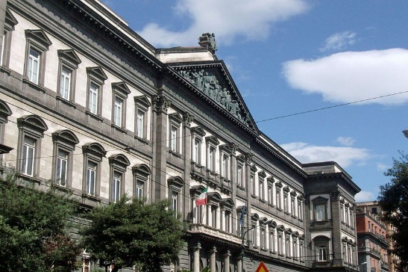
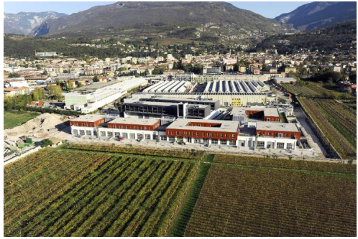
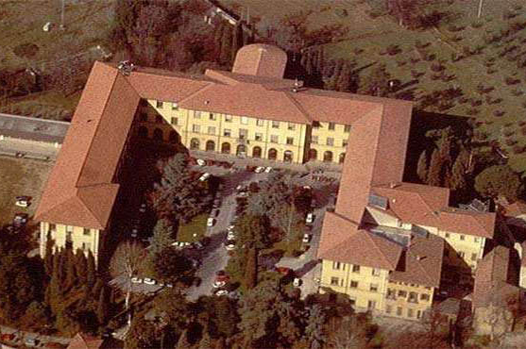
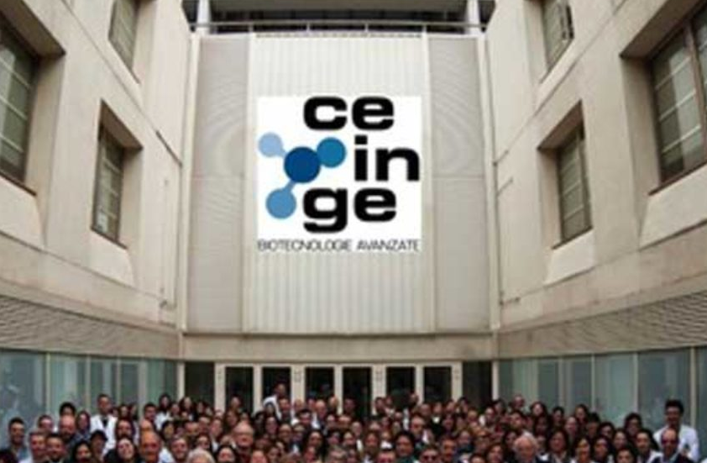
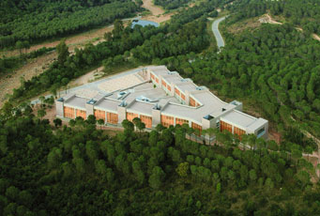
Key players
RESEARCH & DEVELOPMENT INSTITUTES
UNIVERSITY ECOSYSTEM
Over 50 universities with life sciences- related programs
16 CNR Centers dedicated to life sciences segments
SCIENCE PARKS & INNOVATION HUBS
6 science parks
12 Life sciences centers of excellence
28

Slide 29
Science and
Tech Universities
1
2
In general, Italian universities improved their positions in the World University Ranking: 4 more than last year!
Over 50 Universities have programs regarding the field of life sciences, such as:
  Pharma and pharma trades
  Biotech and biotech trades
  Biology
  Chemistry
  Medicine and veterinary medicine
  Biomedical engineering
8
3
3
4
1
3
3
1
4
3
1
3
5
1
2
2
3
Sources: QS World University Rankings by Subject 2020; MIUR (Ministry of Education University and Research)
29
Notes:
REGIONE E NOMI ATENEI COME DA MIUR
Puglia: Bari, Foggia, Salento
Basilicata: Basilicata
Emilia-Romagna: Bologna, Ferrara, Modena e Reggio Emilia, Parma
Lombardia: Brescia, Insubria, Milano, Milano Politecnico, Milano S. Raffaele, Milano Bicocca, Rozzano (MI) Humanitas, Pavia
Sardegna: Cagliari, Sassari
Calabria: Calabria, Catanzaro
Marche: Camerino, Marche, Urbino
Sicilia: Catania, Messina, Palermo
Abruzzo: Chieti e Pescara, L’Aquila, Teramo
Toscana: Firenze, Pisa, Siena
Liguria: Genova
Molise: Molise
Campania: Napoli Fed. II, Napoli Parthenope, Napoli Vanvitelli, Salerno, Sannio
Veneto: Padova, Venezia Cà Foscari, Verona
Umbria: Perugia
Piemonte: Piemonte Orientale, Torino, Torino Politecnino
Lazio: Roma La Sapienza, Roma Tor Vergata, Roma Tre, Tuscia
Provincia di Trento: Trento
Friuli Venezia Giulia: Trieste, Udine

Slide 30
Life sciences
R&D Centers
ITB
(Biomedical Technologies)
Segrate, Milan
IGM
(Molecular Genetics)
Pavia
The National Research Council (CNR) is the largest public research institution in Italy, the only one under the Research Ministry performing multidisciplinary activities, through several institutes.
The Biomedical Science Department in a nutshell:
  16 specialized institutes
  1.302 employees, 870 of which researchers and technologists
  67 owned patents (in diagnostics, innovative pharmaceuticals, biotech, human genome, biosensors)
  Participation in 6 spin-offs
  Participation in several big projects, e.g. EMMA, INFRAFRONTIER, EURO-BIOIMAGING, and more.
Naples:
IBB
(Biostructures and Bio-images)
IBP
(Proteins Biochemistry)
IEOS
(Endocrinology and Oncology)
IGB
(Genetics and Biophysics)
IFC
(Clinical Physiology)
Pisa
IN
(Neuroscience)
Pisa
Rome:
IBCN
(Cellular Biology)
IBPM
(Biology and Molecular
Pathology)
IFT
(Translational Pharmacology)
IBIOM
(Bio-membranes, Bioenergy, and Molecular Biotech)
Bari
IRGB
(Genetics and Biomedical)
Monserrato, Cagliari
ISN
(Neurology)
Cosenza
IBFM
(Bio-images and Molecular Physiology)
Palermo
IBIM
(Molecular Immunology)
Palermo
Source: CNR website
30
Notes:
Centri CNR
IBB, Napoli: Istituto di Biostrutture e Bioimmagini
IBCN, Roma: Istituto di Biologia Cellulare e Neurobiologia
IBFM, Palermo: Istituto di Bioimmagini e Fisiologia Molecolare
IBIM, Palermo: Istituto di Biomedicina e di Immunologia Molecolare «Alberto Monroy»
IBIOM, Bari: Istituto di Biomembrane, Bioenergetica e Biotecnologie Molecolari
IBP, Napoli: Istituto di Biochimica delle Proteine
IBPM, Roma: Istituto di Biologia e Patologia Molecolari
IEOS, Napoli: Istituto per Endocrinologia e Oncologia «Gaetano Salvatore»
IFC, Pisa: Istituto di Fisiologia Clinica
IFT, Roma: Istituto di Farmacologia Traslazionale
IGB, Napoli: Istituto di Genetica e Biofisica «Adriano Buzzati Traverso»
IGM, Pavia: Istituto di Genetica Molecolare
IN, Pisa: Istituto di Neuroscienze
IRGB, Monserrato (Cagliari): Istituto di Ricerca Genetica e Biomedica
ISN, Cosenza: Istituto di Scienze Neurologiche
ITB, Segrate (Milano): Istituto di Tecnologie Biomediche
Big projects:
EMMA: European Mouse Mutant Archive and data Base finalizzato alla creazione di un magazzino biologico per la simulazione delle malattie umane presso l’Istituto di Biologia Cellulare e Nero-biologia a Monterotondo
INFRAFRONTIER: progetto strategico ESFRI per organizzare due reti di infrastrutture europee complementari e collegate nell’ambito dei fenotipi e dell’archivio di modelli di topi per la ricerca biomedica e genetica
EURO-BIOIMAGING: infrastruttura di ricerca europea – offre un accesso ai ricercatori italiani e stranieri alle tecnologie innovative di imaging bio-logico e medico

Slide 31
European Institute of Oncology,
Mario Negri Institute,
Milan Innovation District,
San Raffaele hospital,
Milan
Science Parks
& innovation hubs
Open Zone, Milan
Burlo Garofolo Children’s Hospital, Trieste
Among the main Science Parks operating in the field of Life sciences, we find:
  The Science and Tech Park of Sardinia equipped with Tech Platforms available for companies
  Castel Romano Technopole in Rome hosting several labs and companies, some of which dedicated to experimental research, food biotech and testing, biomedical R&D
  The TLS Park in Siena hosting GSK Vaccines and Diagnostics R&D activities
  The Canavese Bio Industry Park in Turin dealing with scientific results in the fields of Chemistry, Molecular Biology, Proteomic, and Bioinformatics
  The AREA Science Park in Trieste operating in the fields of Biotech, Diagnostics, Chemicals, and Biomedical Technology at European level
  Open Zone in Milan, a scientific healthcare campus focused on open innovation
Italy also hosts many other life sciences-related centers of excellence, a selection of which is indicated in the map
Canavese Bio Industry Park,
Turin
AREA Science Park, Trieste
Candiolo Cancer Research Institute,
Turin
Rizzoli Orthopedic Institute, Trieste
Giannina Gaslini Institute,
Genoa
Toscana Life Sciences Park,
Siena
Castel Romano Technopole, Rome
Tecnomed Puglia,
Bari
R. Elena Institute,
Bambino Gesù
Pedriatric Hospital,
Rome
CEINGE,
TIGEM,
Naples
Biotecnomed,
Catanzaro
Science and Technology Park of Sardinia, Cagliari
31
Notes:
Science parks have operational links with universities, higher education institutions or advanced research centers.
Castel Romano Technopole in Rome: https://www.tecnopolo.it/tecnopolo-castel-romano-2/settori-di-attivita-2/
OpenZone in Milan: https://www.openzone.it/it/know/chi-siamo

Slide 32

Selected incentives and fiscal benefits

Slide 33
INCENTIVES
Large investments – Development contract
Development contract is the main incentive managed by Invitalia. It consists of incentives for one or more connected and functional investment projects (including R&D) of at least € 20 MLN over 3 years, presented by one or more companies also in joint form, in the following sectors:
Manufacturing of electronic components, semiconductors, hardware equipment;
IT and TLC services.
Projects presented by foreign companies providing a strategic investment of at least € 50 MLN can access to Fast Track procedure:
Possibility to jump the queue;
Ad hoc resources;
Time shortening procedures.
The development contract includes various forms of financial subsidies:
Non-repayable grant;
Soft loan (max 3+10 years with subsidized interest rate);
Subsidies for interest repayment on loan.
33

Slide 34



INCENTIVES
Large investments – Development contract
LARGE
MEDIUM
SMALL
ICT manufacturing and services
Southern Regions: Campania, Apulia, Basilicata, Calabria, Sicily and Sardinia
25%
35%
45%
Central-Northern Regions:
only listed cities
10%
20%
30%
H
Rest of Italy
No eligibility
10%
20%
R&D
All the Italian
territory
50% industrial research
25% exp. development
80%
The effective mix of the funds granted can’t exceed 75% of the total eligible expenses.
34

Slide 35
INCENTIVES
Startups and SMEs – Smart & Start Italy
What
The aid supports the creation and growth of innovative startups all over Italy.
Projects must include expenses and eligible costs between € 100K and € 1.5 MIL.
Projects must have a duration not exceeding 24 months, starting after the contract signing.
The valuation procedure lasts only 60 days.
Who
Smart&Start Italy funds the creation and growth of innovative startups that:
Have a strong technological dimension;
Operate in the digital economy;
Enhance search results (spin-offs from research).
Small-sized startups established for no more than 60 months or individuals willing to set up a new company (within 30 days from admission)
Non-Italian Startups must demonstrate the registration in the special section of the Business Register and availability of an Italian operating office.
Subsidies
Interest-free loan up to 80% of the total investment. The percentage of funding may rise to 90% if the startup is composed exclusively by women or young people under the age of 36, or if it includes at least one Italian PhD who is working abroad and intends to return to Italy.
Startups based in Abruzzo, Basilicata, Calabria, Campania, Molise, Puglia, Sardinia and Sicily, will repay only the 70% of the loan amount.
The loan-repayment duration is 10 years.
Startups established by no more than 12 months can use a free of charge technical-management tutoring service by Invitalia.
35

Slide 36
INCENTIVES
Startups and SMEs – Smart & Start Italy
Eligible expenses *
Investment costs:
System, machinery and technological or scientific technical equipment (factory-fresh);
Hardware and software;
Patents, licenses and trademarks;
Certifications, know-how, unpatented technical knowledge;
Design, development, customization and testing of computer architectural solutions and of production technological systems, specialist technological consultancy if functional to the project, investments in marketing and web marketing.
Running costs:
Employees and collaborators wages;
Licenses and rights for industrial property;
Software licenses;
Incubation and acceleration services;
Lease payments, rental costs and amortization fees of systems, machineries and technological equipment not already financed as above;
Interest on external financing.
* Expenses are eligible only if incurred after the date of the proposal submission
36

Slide 37
FISCAL BENEFITS
R&D and Innovation tax credit
ELIGIBILITY
INCENTIVES
Companies of all sizes investing in research and development, ecological transition, technological innovation 4.0 and in other innovative activities
Eligible activities | Investments (€) ** | Tax credit (%) *
Fundamental research, Industrial research and Experimental development | ≤ € 3 MLN | 12%
Fundamental research, Industrial research and Experimental development for innovative startups and SMEs | ≤ € 3 MLN | 24%
Fundamental research, Industrial research and Experimental development in Southern Regions (Abruzzo, Basilicata, Calabria, Campania, Molise, Puglia, Sardegna and Sicilia) | ≤ € 3 MLN | 25% (large enterprise) 35% (medium enterprise) 45% (small enterprise)
Technological innovation (design, implementation, introduction) | ≤ € 1.5 MLN | 6%
Technological innovation “Industry 4.0” and green economy (design, implementation, introduction) | ≤ € 1.5 MLN | 10%
Design - Aesthetic conception (conception and realization of new products and samples within the textile and fashion, footwear, eyewear, goldsmith, furniture and furnishing and ceramic sectors) | ≤ € 1.5 MLN | 6%
ELIGIBLE EXPENSES
Personnel;
Depreciation charges, financial or simple lease payments and other expenses relating to tangible assets and software used in R&D projects (up to 30% of the expenses related to personnel);
Research contracts;
Depreciation charges relating to the purchase from third parties, also under license of use, of industrial property rights relating to an industrial or biotechnological invention, up to a maximum of € 1 MLN;
Consultancy (up to 20% of the expenses related to the personnel);
Materials for R&D projects (up to 30% of the expenses related to personnel or research contracts).
The effective payment of the eligible expenses must result from a specific certification issued by a company’s statutory auditor. For companies not legally obliged to audit statutory accounts, the costs incurred are recognized for an amount not exceeding € 5,000.
* Compensation
3 years
** net of other grants or contributions for any reason received for the same eligible expenses
37

Slide 38
FISCAL BENEFITS
Patent box and equity growth
PATENT BOX
ACE – Help for Economic Growth
The patent box benefit consists in a partial tax deduction of 50% for incomes arising from direct use or licensing of qualified intangible assets:
Property rights;
Industrial patents;
Trademarks;
Designs and models, as well as processes, formulas and information relating to experiences acquired in legally protected industrial, commercial or scientific fields
Fiscal deductibility on IRPEF (personal income tax) or IRES (tax on company revenues)
Legal entities with a business income must be able to demonstrate that their income is from the use of intangible assets
Access to the benefit is automatic in the preparation of financial statements and for a 3-years time period, providing adequate documentation
The incentive aims at encouraging the capitalization of companies through the possibility of deducting from the net income, up to the amount of the same, an amount (notional yield) determined as an increase in equity.
The applied tax rate on company revenue (IRES) only for this specific amount is 1.3%.
To calculate the ACE incentive, the positive and negative elements of the capital increase must be algebraically added
The result obtained must be compared with the shareholders' equity resulting from the financial statements for the year including the profit or loss. The tax base is equal to the lower of the two amounts.
38
Notes:
Deduction (deduzione): reduction of the tax base (taxable income)

Slide 39
FISCAL BENEFITS
Investments in innovative startups/SMEs
ELIGIBILITY
INCENTIVES
Legal or natural persons investing directly or indirectly in one or more innovative startups or SMEs
Mature companies invest in the acquisition of the entire share capital of innovative startups, only if the acquisition is maintained for at least 3 years
The benefit applies to contributions in cash in the company share capital and in the reserves of innovative startups and SMEs or of companies investing mainly in the capital of innovative startups or SMEs
Fiscal subject | Investments (€) |  | Fiscal deductibility (%)
Natural persons | ≤ € 1 MLN | 50% *
Legal persons | ≤ € 1.8 MLN |  | 60% *
Mature companies | ≤ € 15 MLN |  | 100% *
* Waiting for final approval. The existing regulation provides a 30% and 50% fiscal deductibility
WHAT
Fiscal deductibility on IRPEF (personal income tax) or IRES (tax on company revenues)
39

Slide 40
FDI focus

Slide 41







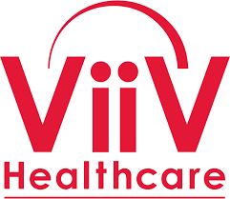









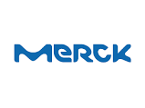






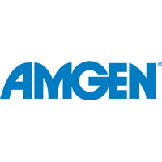




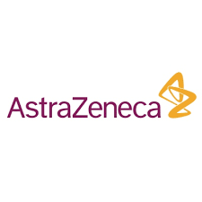







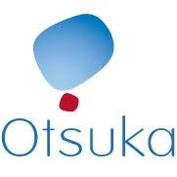

Home to international players
Some Pharma global leaders with recent investments in Italy
with R&D labs, manufacturing activities, and more
143 LS foreign owned firms in Italy with over 40K employees and more than € 21 bln turnover yearly
(Nace Code C-21)
Source: Reprint database.
41
Notes:
143 Life sciences foreign owned firms (C-21) with 40.064 employees and € 21.457,1 mln turnover in 2017

Slide 42





Foreign investments in Italian startups
The Italian startup Okairos (vaccines):
set up in 2007, collected €23,2 mln before being acquired by GSK in 2013 for €250 mln
The Italian startup VivaBioCell (stem cells):
set up in 2007 and acquired by NantCell for an est. value of €60 mln in 2015
The Italian biotech startup Genenta Science (oncology):
collected in 2015 €10 mln, to date €17 mln
The Italian startup Exosomics Siena S.p.A. (diagnostics):
in 2017, the Swiss Lonza made a strategic investment in Exosomics Siena S.p.A. (undisclosed value)
The Italian startup Creabilis Therapeutics (dermatology & inflammatory diseases):
acquired by the US-based Sienna Biopharmaceutical for $150 mln
42
Source: Assobiotec/Federchimica

Slide 43




Foreign investments in Italian companies
The Italian biopharma Ethical Oncology Science (oncology):
set up in 2006, collected €25 mln before being acquired by Clovis Oncology for €420 mln
The Italian drugmaker Gentium (epatology):
set up in 2001, acquired by Jazz Pharma for $1 bln.
In 2013, it registered 600% growth rate in less than 12 months
Nogra Pharma, part of the Giuliani Pharma Group (gastro-intestinal area):
acquired in 2014 by Celgene for $2,5 bln
MiaMed
The Italian biotech university spin-off MiaMed (rare diseases):
in 2016, Amicus Therapeutics acquired the UniBo spin-off for $90 mln
The Italian Genoma – Molecular Genetics Laboratories Group:
in 2017 was acquired by Eurofins (undisclosed value)
43
Source: Assobiotec/Federchimica

Slide 44


